Slide 1

Solving Loyalty
Binary Beast

Slide 2
Key Question
Situation
How might we drive non-AAdvantage member customers to effortlessly enroll in the program without causing friction in the operation?
Only ½ of the people on American Airlines flights are AAdvantage Members
Lack of Awareness and Understanding about the Loyalty Program and its benefits

Slide 3
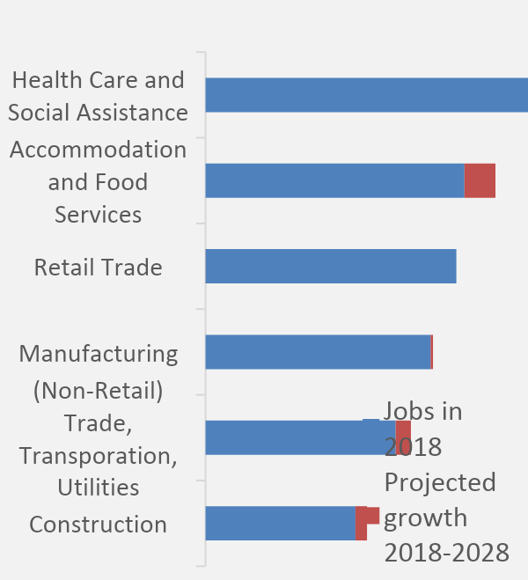
Our
Solution
Buddy AAdvantage
An app that increases enrollment in the Loyalty AAdvantage program through a refer a friend incentive system

Slide 4




Takeaways
Buddy AAdvantage utilizes “Word of Mouth”
Appeals to Gen-Z generation
It can be implemented within the American app making it seamless
Saves money in Advertising
Notes:
1.All it takes is 1 AAdvantage person to refer their mom, friend, neighbor, tell them about the Loyalty program and Rewards. This plays into the influencer culture. Word of mouth can reach all demographics of travler.

Slide 5


Demo
Incentives: Current AAdvantage 3 months Apple Music
Step 1:
The current AAdvantage member sends an email to the referral
Step 2: Referral accepts invite and completes sign up
Step 3: Referral becomes AAdvantage member and incentive rewarded.
Incentives: Referral gets free checked back or miles
Notes:
Tay, is already an AADvantage Member who has been notified that him and a friend can get rewards (like 3 months of apple music, mileage points, or a day pass of Admirals club, even if someone doesn’t travel they can earn points) to refer a program that he already loves, so he immediately thinks of his best friend Quan, types in his email, sends the link and information about the AAdvantage, Quan signs up, and then they both get rewards.

Slide 6
Questions?

